Slide 1

Project Defence
Title: Temperature Detector Using Arduino UNO & DHT11 Sensor
Group: 03
Instructor: Prof. Dr. Rashed Mazumder (Rmz1)

Slide 2
Members
Name: Uchchwas Das
ID: 1620016042
Name: Md. Nahid Hasan
ID: 1620847042
Name: Md.Tahrim Faroque Tushar
ID: 1621148642
Name: Abdullah Ibne Ali
ID: 1711200642
Course: CSE323
Sec: 09

Slide 3
Per-Member responsibility
Uchchwas Das – Sending alert message through API
Md.Tahrim Faroque Tushar – Coding Part Of The Project
Md. Nahid Hasan - Hardware part
Abdullah Ibne Ali – Hardware part

Slide 4
Project design according to SDLC
We are using waterfall model here. As the Waterfall Model illustrates the software development process in a linear sequential flow, and also it is suitable for small size project. So we are applying it in our project.

Slide 5
Equipment
DHT11 Temperature And Humidity Sensor
Arduino UNO
16*2 LCD display
10k trim pot
10k resistor
Breadboard
Connecting wires

Slide 6
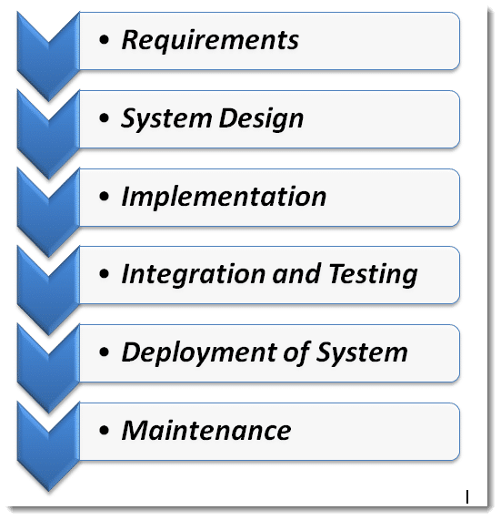
Steps Of Water Fall Model

Slide 7
1. Requirements
We will make a temp and humidity detector type project which collect data through sensor and react based on temperature and our estimated cost is 1K, estimated time is 4 weeks.
We will use temperature and humidity sensor(DHT11) to calculate the temperature around us and also, we can see it in LCD screen and in Arduino console. We will use Arduino with Windows operating system to make it and control it. There will be other components like breadboard, resistors etc.

Slide 8
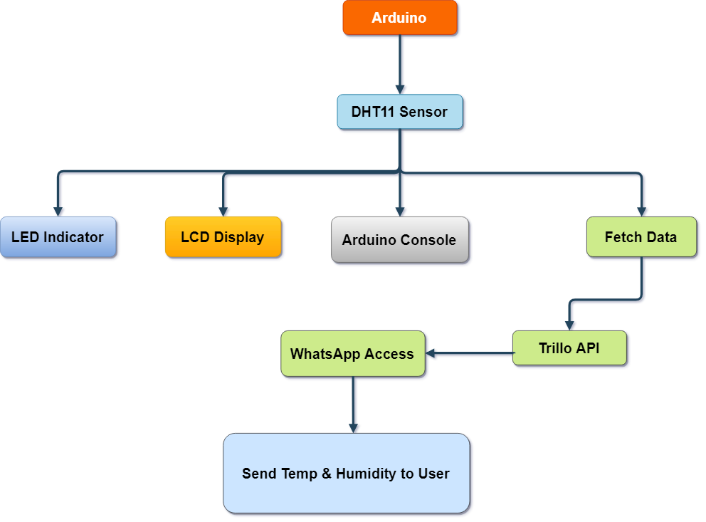
2. System Design

Slide 9
3. Implementation
We have done installing Arduino 1.7.8 software in windows 10.
We also installed necessary libraries named DHT11 and Wire.
At first, we connected the DHT11 sensor to our Arduino UNO and implement the coding part for showing results in the Arduino console.
Then, we move to our hardware part.
Finally, we connected the LCD display to show the result in the display.
Additionally, added the trim pot to control the brightness in the LCD.
We added messaging system, using Trillo API, so that we can get notified in the event of critical temperature situation.
We also added 6 LEDs to indicate different temp situation.

Slide 10
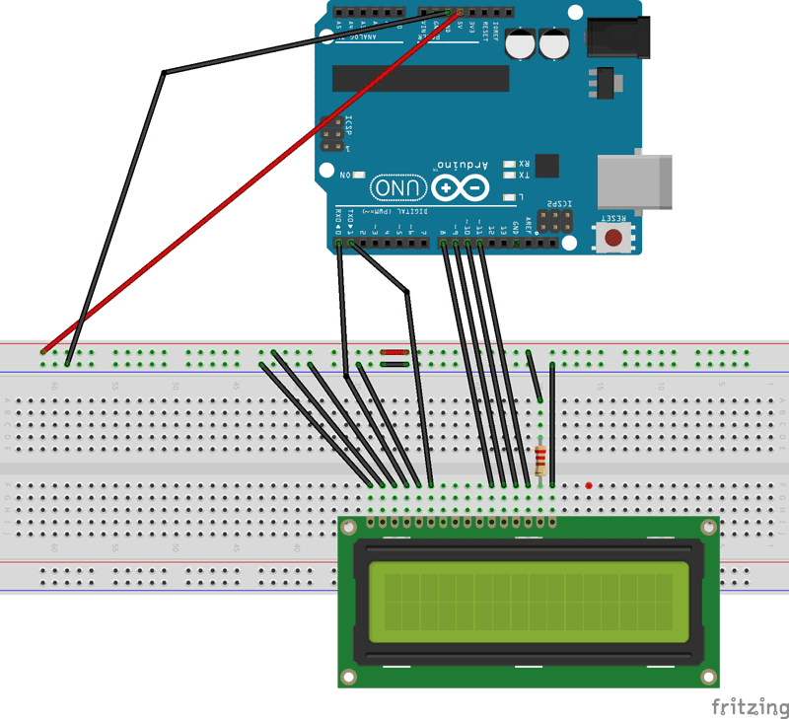
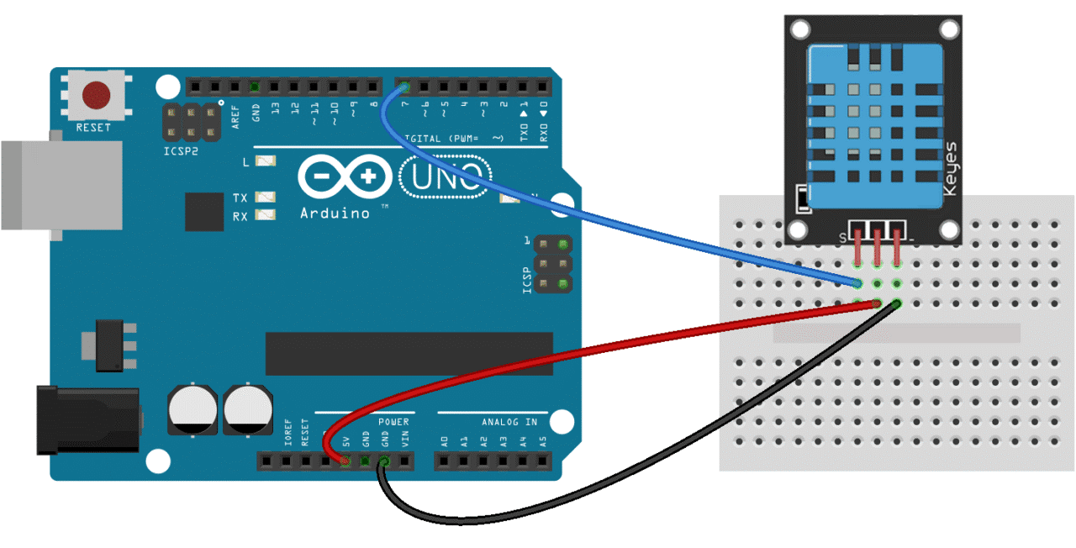
1
2

Slide 11
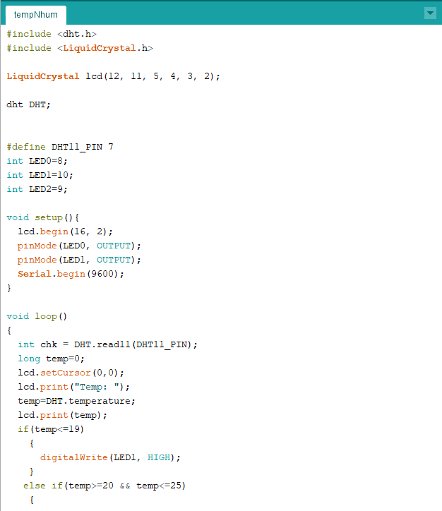
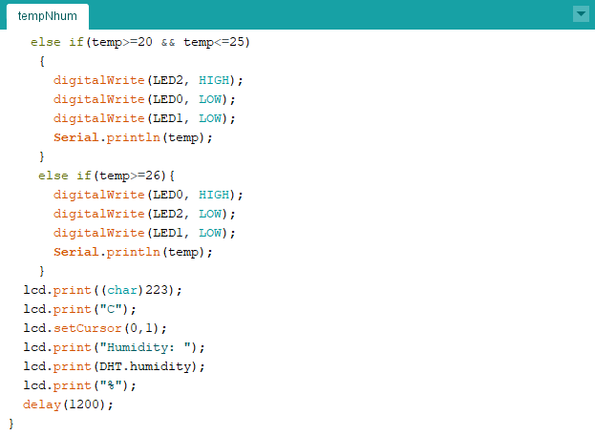

Slide 12
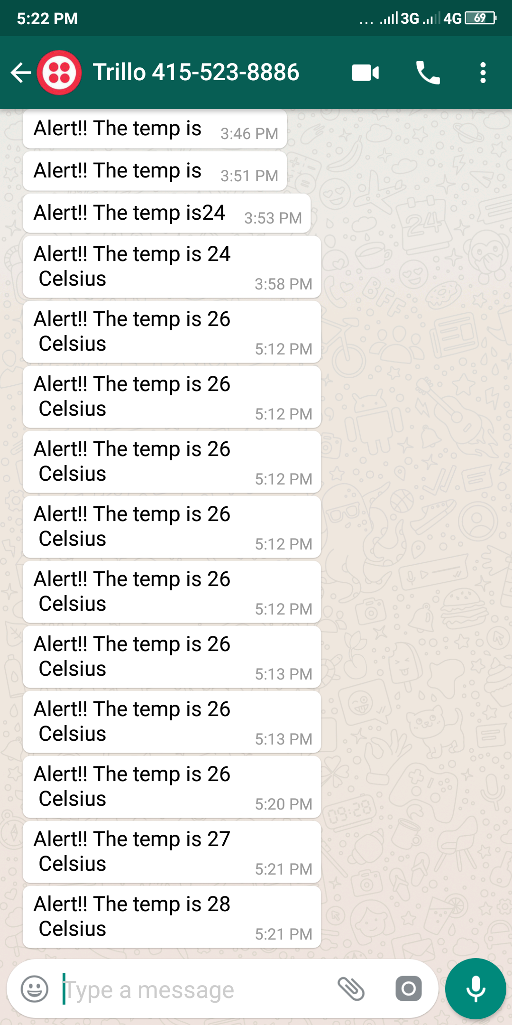
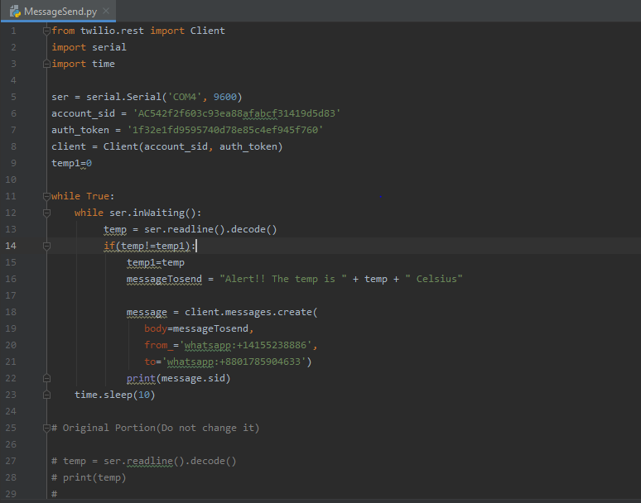

Slide 13
4. Integration & Testing
After the implementation, we connected the Arduino with a PC.
Then, implement the necessary code to check if the sensor is working in the Arduino console. And it showed the temp and humidity with 99.01% accuracy.
Then, we implement the code for showing the data into the LCD.
Everything worked perfectly so far.
We tested our project in different places of NSU and for humidity we tested it with tissue paper or hot cup of tea. It was showing the results with different temp and humidity rating.
Also, tested the message sending system and it was working perfectly.

Slide 14
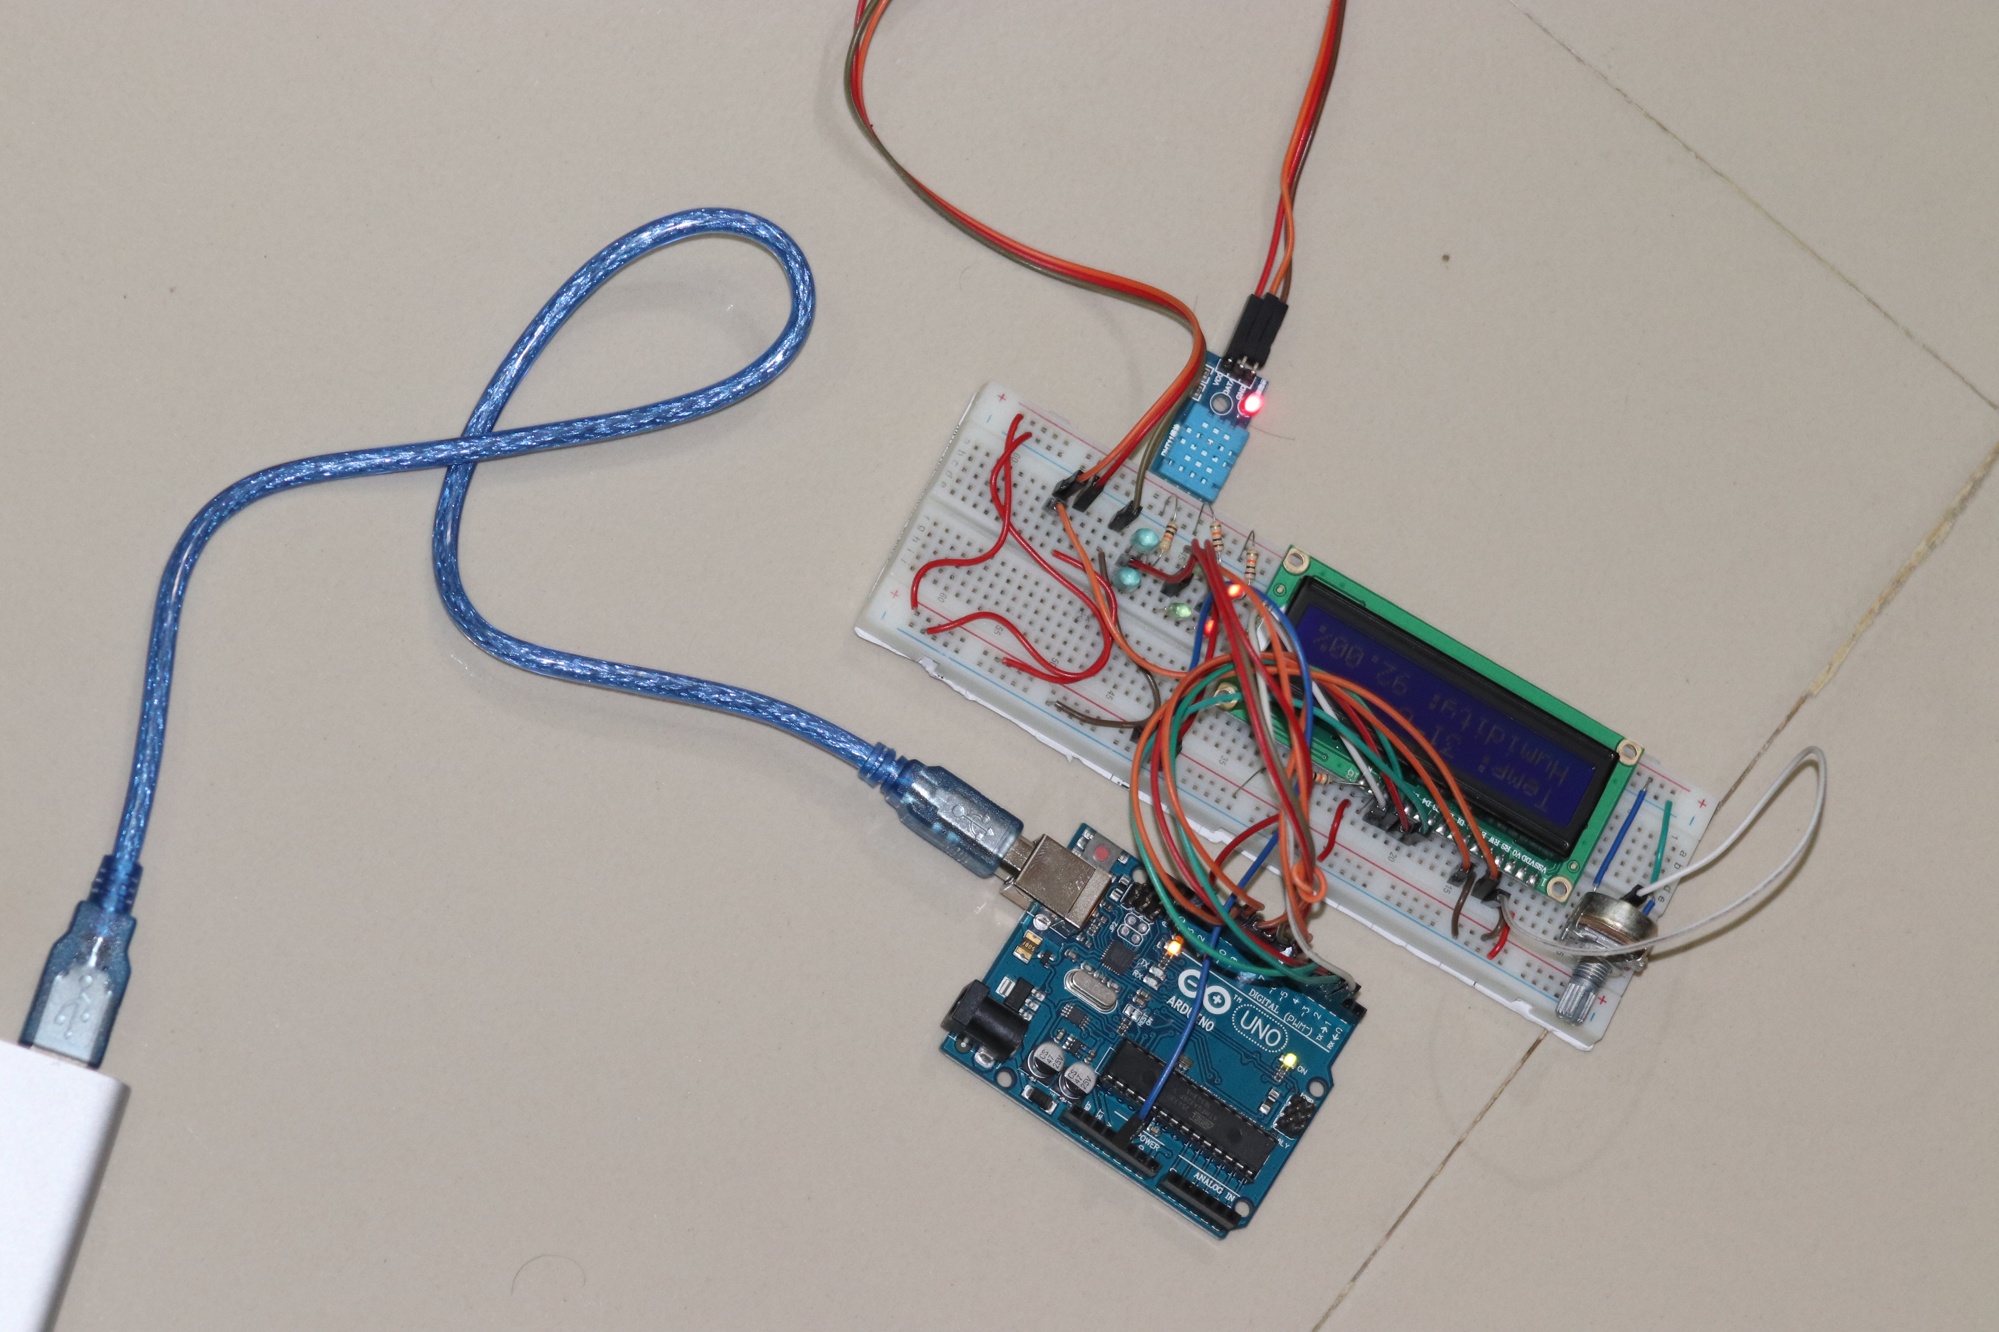

Slide 15
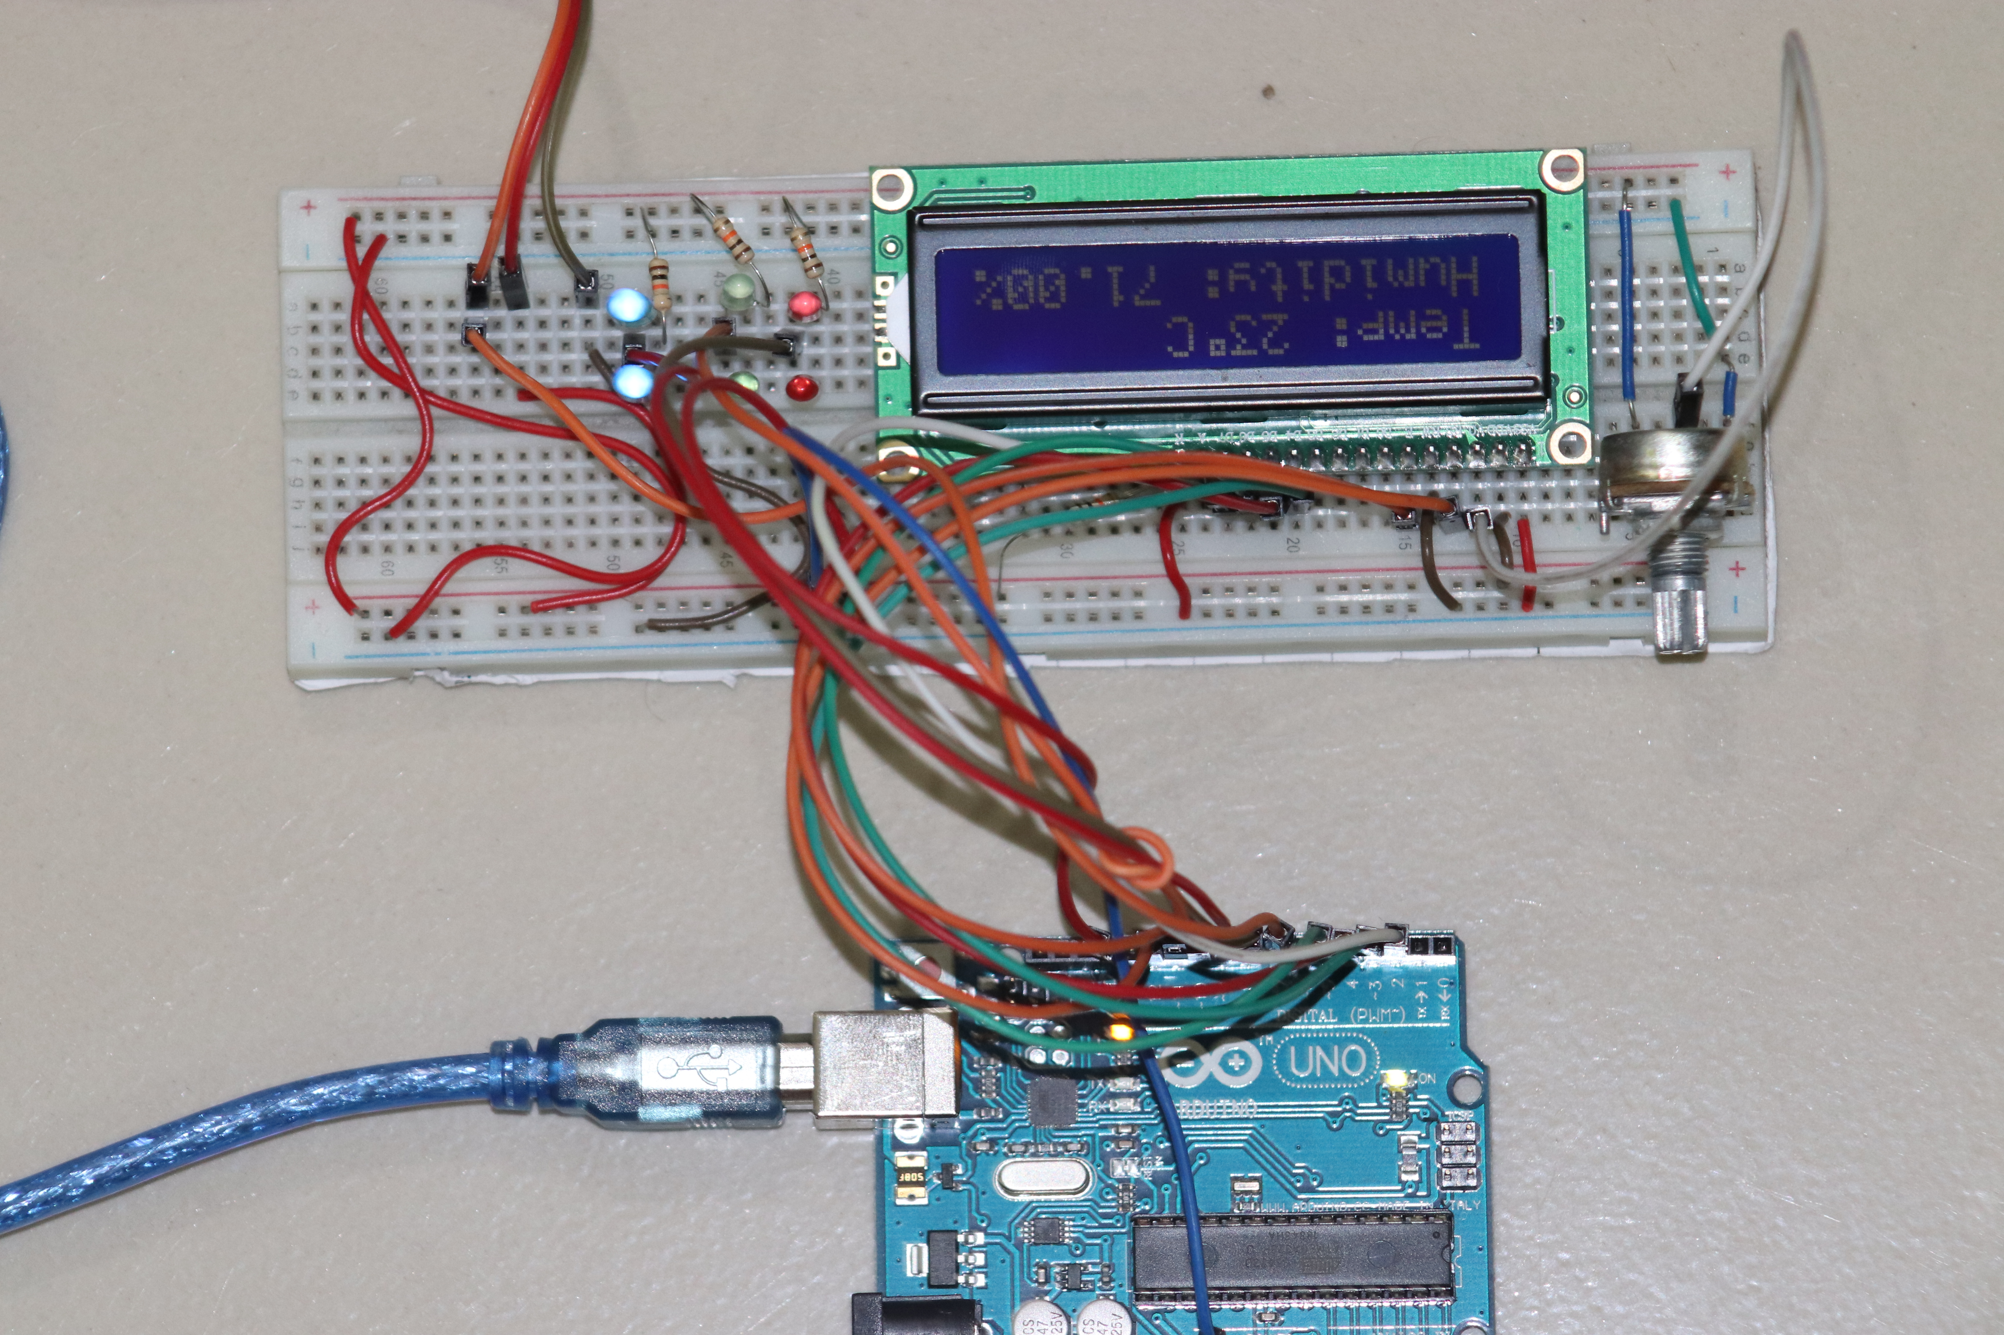

Slide 16
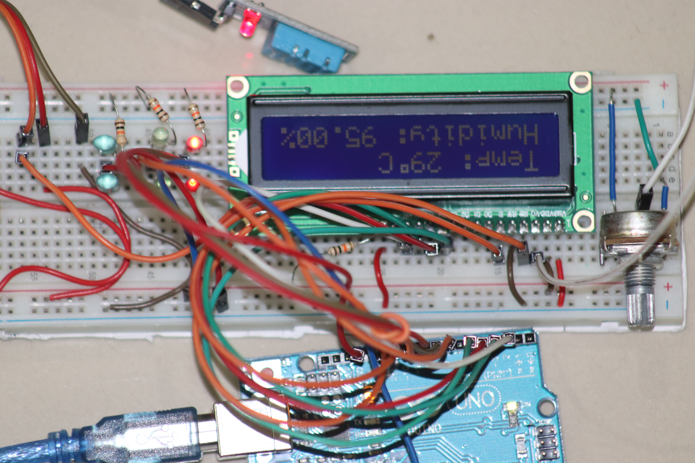

Slide 17
5. Deployment of system
We did not launch our product in the market yet.

Slide 18
6.Maintenance
We have upgraded our code for sending the temp and humidity to mobile devices via Whatsapp.
Also, changed some of the LEDs that was not working properly.

Slide 19
Feasibility
We can use our product in various situations such as in the small size server room. Server room needs to be cooled down all the time because excessive heat can damage the server. So, we can use this temperature detector with some further modification, such as sending signals when to modify suitable temperature.
We can also use this in our household water tank for tracking the temperature. We can also use this in our water heater, for auto switching to cold and warm water flow in our bath, depending on the season.
This type of temperature detector can be used in harsh operating environments like chemical industries, mine plants, various heat producing hardware etc.

Slide 20
Cost
No | Items | Quantity | Rate | Total amount
1. | Breadboard (Big) | 1 | 84.9 | 84.9
2. | jumper wires (M to F) 20 pieces | 2 | 29 | 58
3. | LCD Display (16 x 2) with header | 1 | 174.9 | 174.9
4. | Arduino UNO | 1 | 405 | 405
5. | DHT11 Temperature and Humidity Sensor | 1 | 118 | 118
6. | Green LED (5mm) | 2 | 1.31 | 2.62
7. | Red LED (5mm) | 2 | 1.31 | 2.62
8. | Yellow LED (5mm) | 2 | 1.5 | 3
9. | 10k ohm Potentiometer | 1 | 13.8 | 13.8
12. | 10k Ohm 1/4W Resistor | 5 | 1.25 | 6.25
14. | Shipping Cost |  |  | 40
15.
 |  |  | Subtotal: | 909.09‬ Taka

Slide 21
Thank You

